Slide 1
Procurement Optimization Weekly Review
26th May 2024
Panasonic Industrial Devices
Singapore Pte Ltd
(PIDSG)

Slide 2
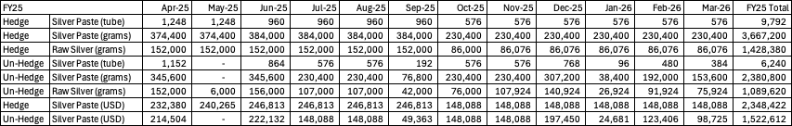
Data from PIDSG
1522612.3
1522612.3
Silver paste contains approx. 41% of raw silver
Total unhedged raw silver: USD 1,522,612
Including storage: 2.284 Million
1% saving lead to: 22.84K USD
Notes:
Model complexity wise:
Jun: 1 and 2 only, Prob def, evaluation matrices
Dec:
Service development steps: requirement gathering, dev, imp, evaluation

Slide 3
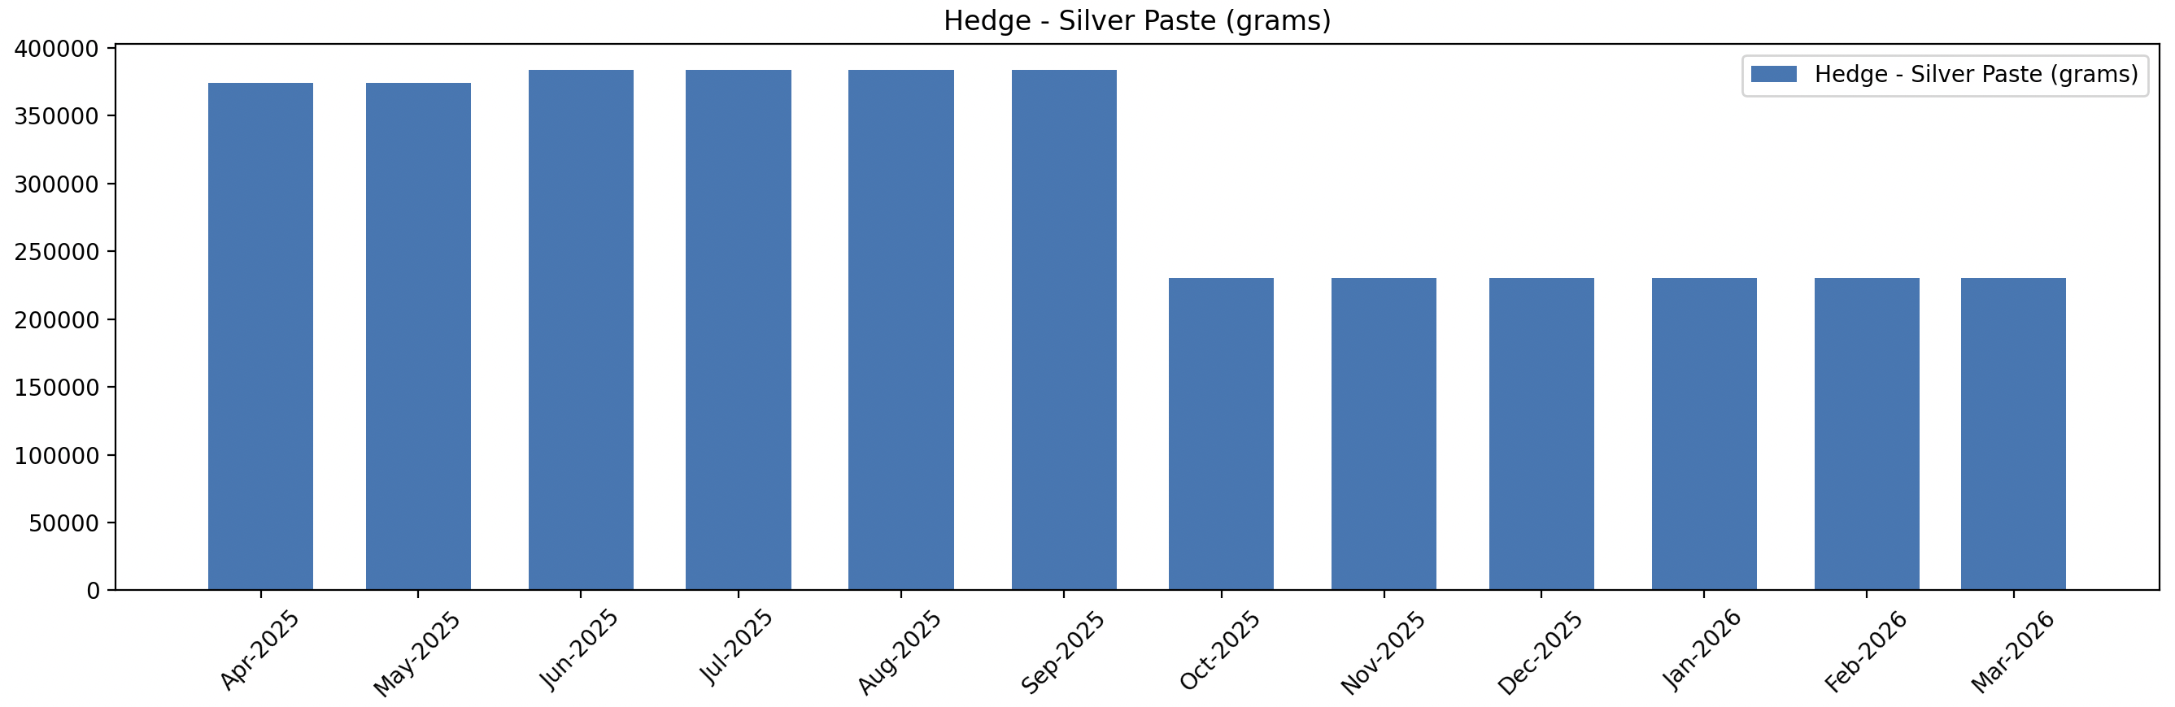
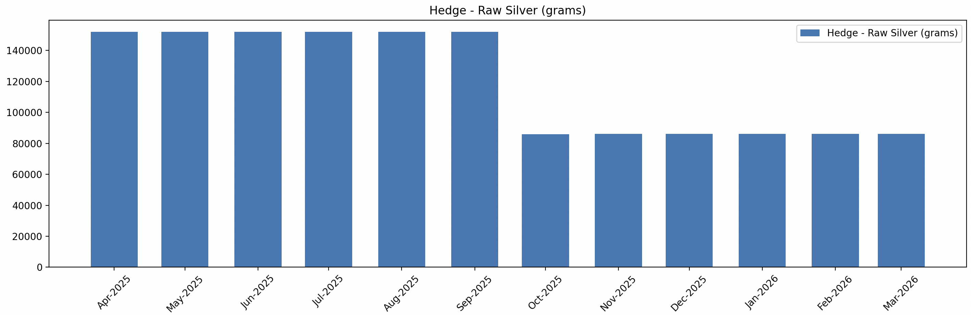
Exploratory data analysis
Almost constant ratio of raw silver in silver paste- with some anomaly
Notes:
Model complexity wise:
Jun: 1 and 2 only, Prob def, evaluation matrices
Dec:
Service development steps: requirement gathering, dev, imp, evaluation

Slide 4
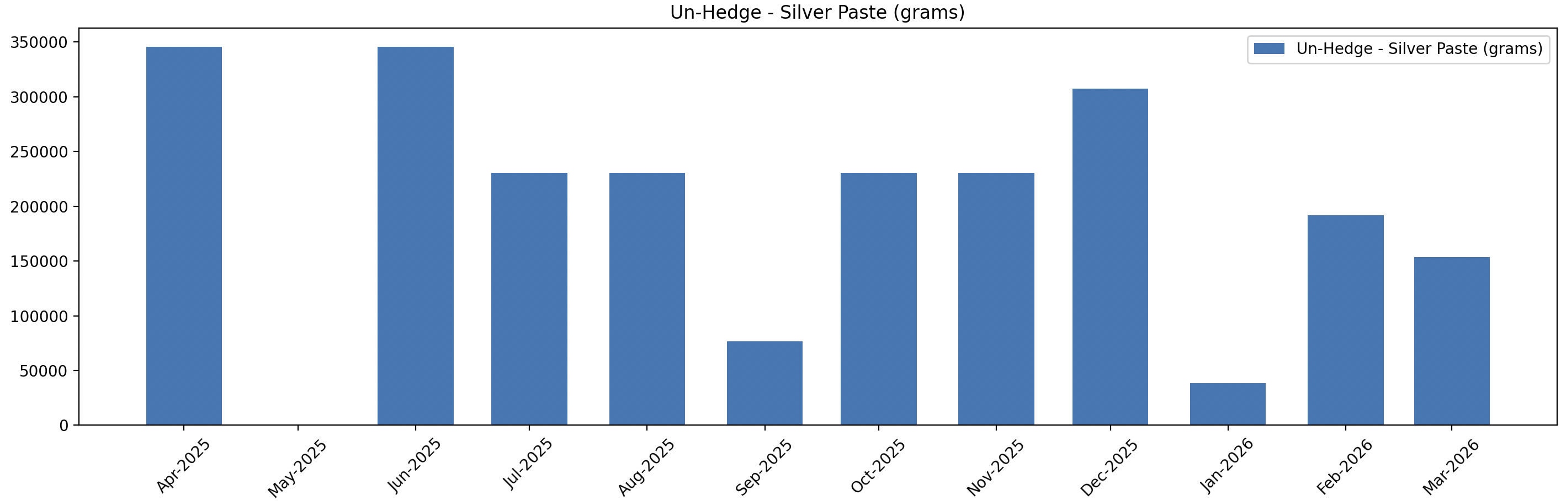
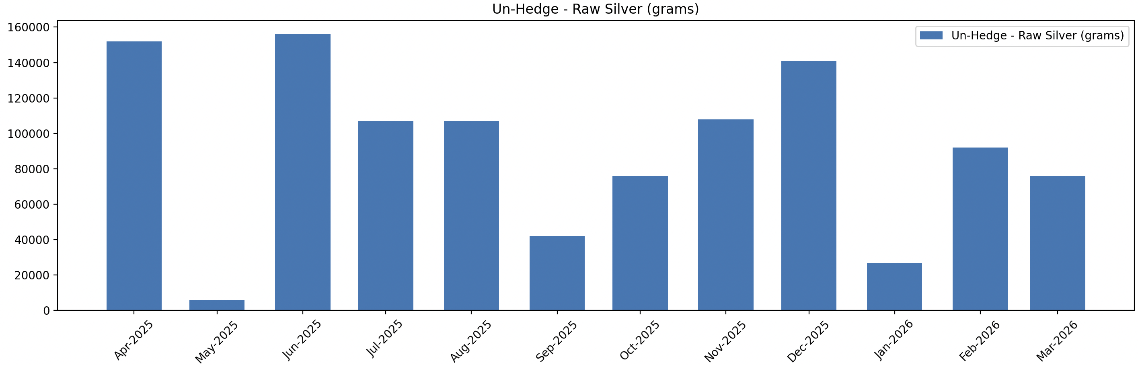
Exploratory data analysis
Hedged: unhedged ratio is much lower than 3 (in vol)
Almost constant ratio
Gm
Notes:
Model complexity wise:
Jun: 1 and 2 only, Prob def, evaluation matrices
Dec:
Service development steps: requirement gathering, dev, imp, evaluation

Slide 5

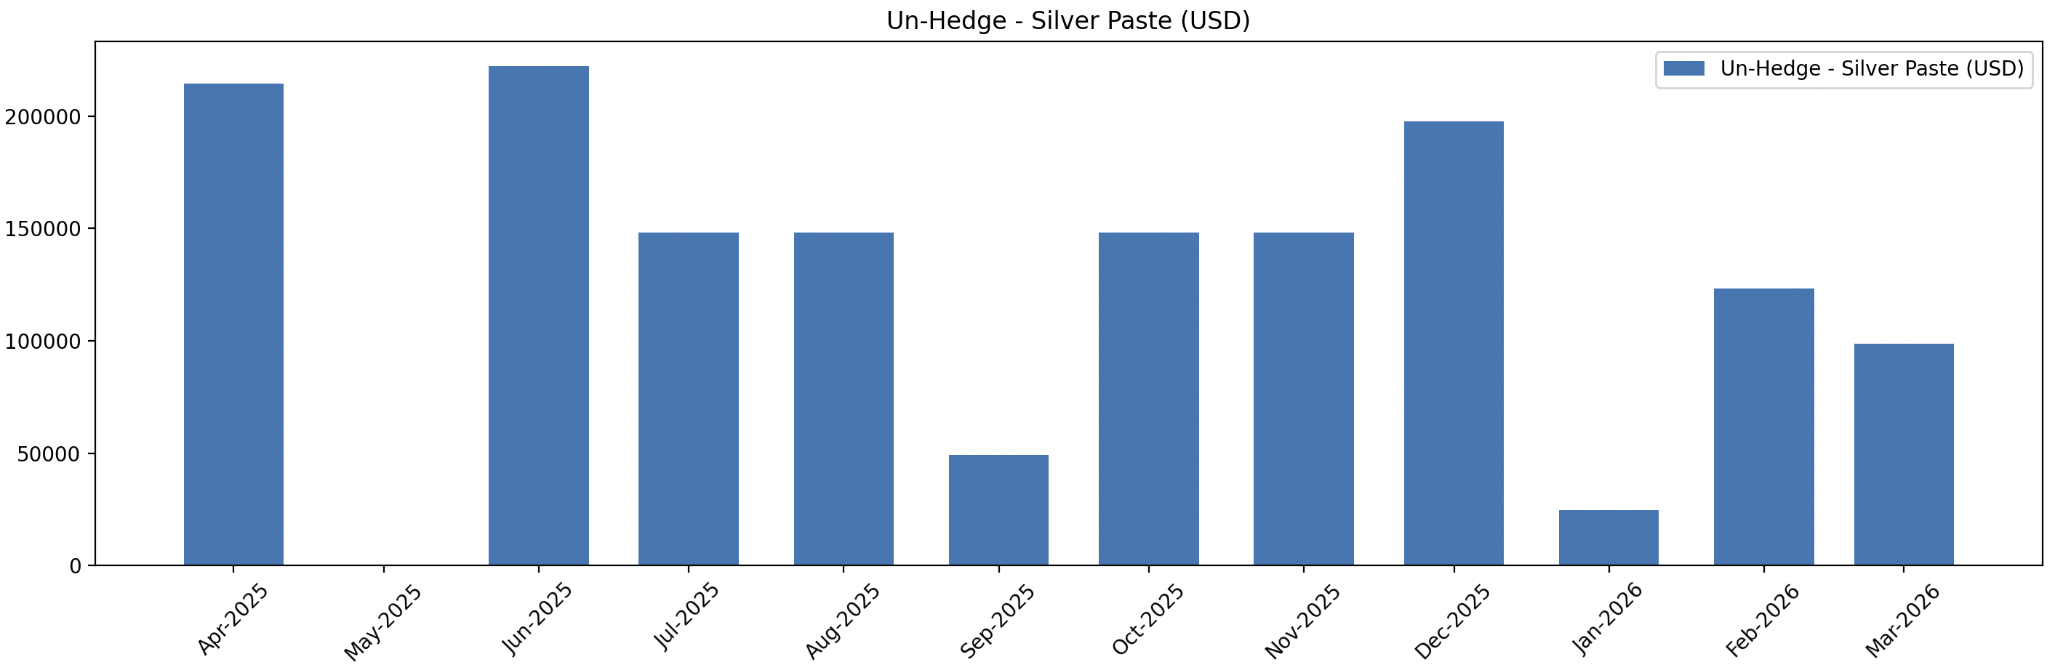
Exploratory data analysis
Hedged: unhedged ratio is much lower than 3 (in USD)
Notes:
Model complexity wise:
Jun: 1 and 2 only, Prob def, evaluation matrices
Dec:
Service development steps: requirement gathering, dev, imp, evaluation

Slide 6
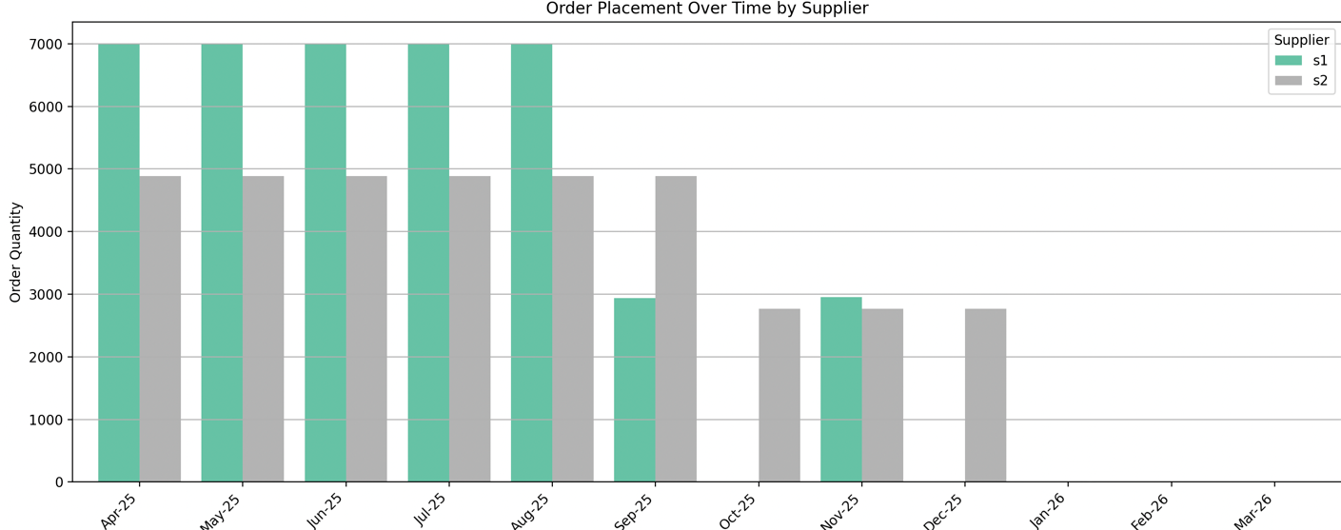
Price SAA
The majority of procurement is scheduled early
Notes:
Model complexity wise:
Jun: 1 and 2 only, Prob def, evaluation matrices
Dec:
Service development steps: requirement gathering, dev, imp, evaluation

Slide 7
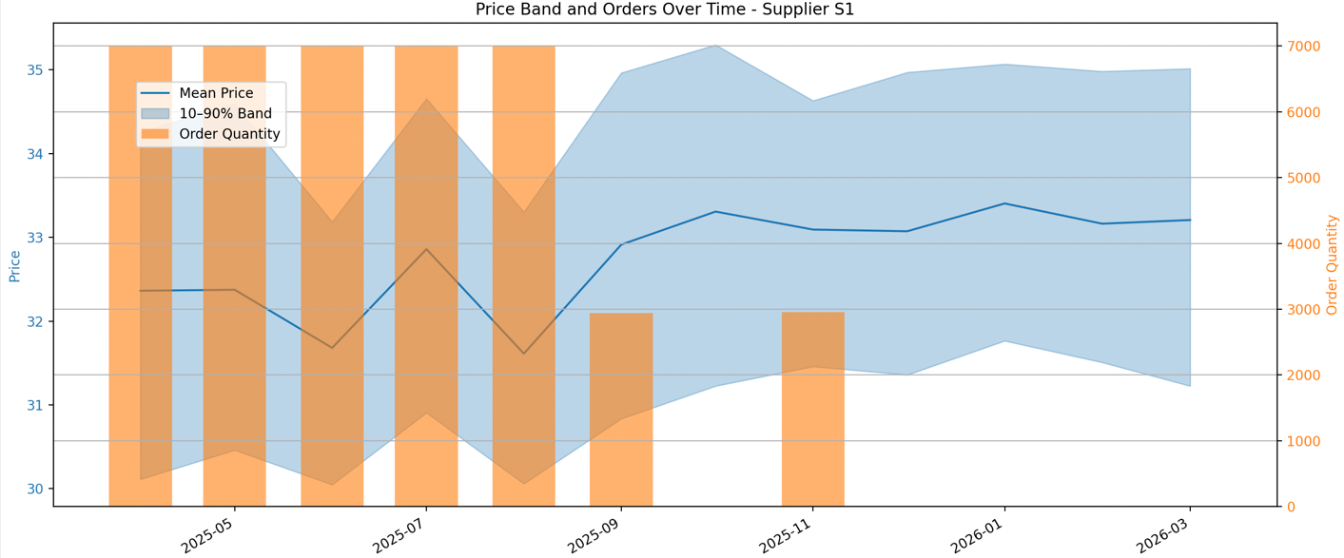
Price SAA
The majority of procurement is scheduled early
Notes:
Model complexity wise:
Jun: 1 and 2 only, Prob def, evaluation matrices
Dec:
Service development steps: requirement gathering, dev, imp, evaluation

Slide 8
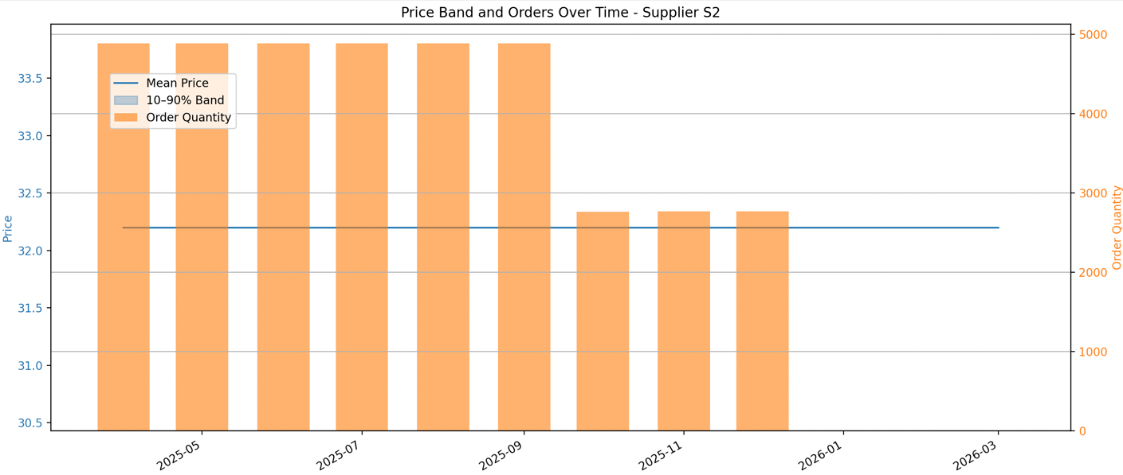
Price SAA
Hedged
Notes:
Model complexity wise:
Jun: 1 and 2 only, Prob def, evaluation matrices
Dec:
Service development steps: requirement gathering, dev, imp, evaluation

Slide 9
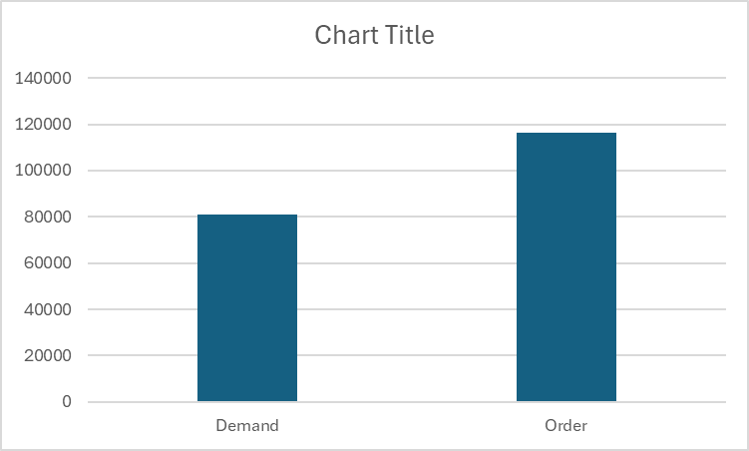
Price SAA
Hedged
Notes:
Model complexity wise:
Jun: 1 and 2 only, Prob def, evaluation matrices
Dec:
Service development steps: requirement gathering, dev, imp, evaluation

